Slide 1
Displaying Data from Multiple Tables

Slide 2
Objectives
After completing this lesson, you should be able to do the following:
  Write SELECT statements to access data from more than one table using equijoins and nonequijoins
  Join a table to itself by using a self-join
  View data that generally does not meet a join condition by using outer joins
  Generate a Cartesian product of all rows from two or more tables
Notes:
Oracle Database 10g: SQL Fundamentals I 5 - <number>
Objectives
This lesson explains how to obtain data from more than one table. A join is used to view information from multiple tables. Therefore, you can join tables together to view information from more than one table.
Note: Information on joins is found in “SQL Queries and Subqueries: Joins” in
Oracle SQL Reference.

Slide 3
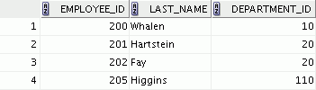
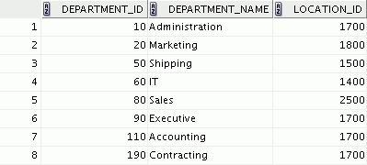



Obtaining Data from Multiple Tables
EMPLOYEES
DEPARTMENTS
…
…
Notes:
Oracle Database 10g: SQL Fundamentals I 5 - <number>
Obtaining Data from Multiple Tables
Sometimes you need to use data from more than one table. In the slide example, the report displays data from two separate tables:
Employee IDs exist in the EMPLOYEES table.
Department IDs exist in both the EMPLOYEES and DEPARTMENTS tables.
Department names exist in the DEPARTMENTS table.
To produce the report, you need to link the EMPLOYEES and DEPARTMENTS tables and access data from both of them.

Slide 4
Types of Joins
Joins that are compliant with the SQL:1999 standard include the following:
  Cross joins
  Natural joins
  USING clause
  Full (or two-sided) outer joins
  Arbitrary join conditions for outer joins
Notes:
Oracle Database 10g: SQL Fundamentals I 5 - <number>
Types of Joins
To join tables, you can use join syntax that is compliant with the SQL:1999 standard.
Note: Before the Oracle9i release, the join syntax was different from the ANSI standards. The SQL:1999–compliant join syntax does not offer any performance benefits over the Oracle-proprietary join syntax that existed in prior releases. For detailed information about the proprietary join syntax, see Appendix C.

Slide 5
Joining Tables Using SQL:1999 Syntax
Use a join to query data from more than one table:
SELECT table1.column, table2.column
FROM table1
[NATURAL JOIN table2] |
[JOIN table2 USING (column_name)] |
[JOIN table2
ON (table1.column_name = table2.column_name)]|
[LEFT|RIGHT|FULL OUTER JOIN table2
ON (table1.column_name = table2.column_name)]|
[CROSS JOIN table2];
Notes:
Oracle Database 10g: SQL Fundamentals I 5 - <number>
Defining Joins
In the syntax:
table1.column denotes the table and column from which data is retrieved
NATURAL JOIN joins two tables based on the same column name
JOIN table USING column_name performs an equijoin based on the column name
JOIN table ON table1.column_name performs an equijoin based on the condition in the ON clause, = table2.column_name
LEFT/RIGHT/FULL OUTER is used to perform outer joins
CROSS JOIN returns a Cartesian product from the two tables
For more information, see “SELECT” in Oracle SQL Reference.

Slide 6
Creating Natural Joins
  The NATURAL JOIN clause is based on all columns in the two tables that have the same name.
  It selects rows from the two tables that have equal values in all matched columns.
  If the columns having the same names have different data types, an error is returned.
Notes:
Oracle Database 10g: SQL Fundamentals I 5 - <number>
Creating Natural Joins
You can join tables automatically based on columns in the two tables that have matching data types and names. You do this by using the keywords NATURAL JOIN.
Note: The join can happen on only those columns that have the same names and data types in both tables. If the columns have the same name but different data types, then the NATURAL JOIN syntax causes an error.

Slide 7
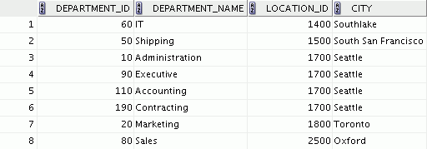
Retrieving Records with Natural Joins
SELECT department_id, department_name,
location_id, city
FROM departments
NATURAL JOIN locations ;
Notes:
Oracle Database 10g: SQL Fundamentals I 5 - <number>
Retrieving Records with Natural Joins
In the example in the slide, the LOCATIONS table is joined to the DEPARTMENT table by the LOCATION_ID column, which is the only column of the same name in both tables. If other common columns were present, the join would have used them all.
Natural Joins with a WHERE Clause
Additional restrictions on a natural join are implemented by using a WHERE clause. The following example limits the rows of output to those with a department ID equal to 20 or 50:
SELECT department_id, department_name,
location_id, city
FROM departments
NATURAL JOIN locations
WHERE department_id IN (20, 50);

Slide 8
Creating Joins with the USING Clause
  If several columns have the same names but the data types do not match, natural join can be applied by using the USING clause to specify the columns that should be used for an equijoin.
  Use the USING clause to match only one column when more than one column matches.
  Do not use a table name or alias in the referenced columns.
  The NATURAL JOIN and USING clauses are mutually exclusive.
Notes:
Oracle Database 10g: SQL Fundamentals I 5 - <number>
USING Clause
Natural joins use all columns with matching names and data types to join the tables. The USING clause can be used to specify only those columns that should be used for an equijoin. The columns that are referenced in the USING clause should not have a qualifier (table name or alias) anywhere in the SQL statement.
For example, the following statement is valid:
SELECT l.city, d.department_name
FROM locations l JOIN departments d USING (location_id)
WHERE location_id = 1400;
The following statement is invalid because the LOCATION_ID is qualified in the WHERE clause:
SELECT l.city, d.department_name
FROM locations l JOIN departments d USING (location_id)
WHERE d.location_id = 1400;
ORA-25154: column part of USING clause cannot have qualifier
The same restriction also applies to NATURAL joins. Therefore, columns that have the same name in both tables must be used without any qualifiers.

Slide 9
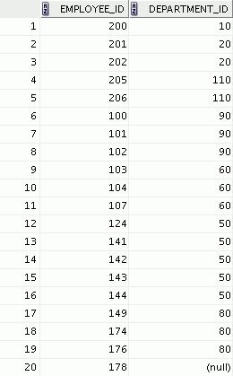
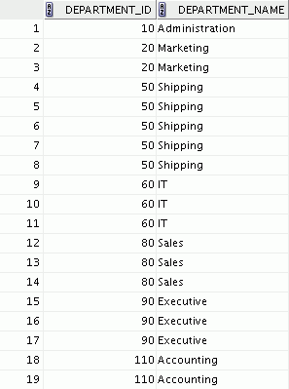
Joining Column Names
EMPLOYEES
DEPARTMENTS
Foreign key
Primary key
Notes:
Oracle Database 10g: SQL Fundamentals I 5 - <number>
The USING Clause for Equijoins
To determine an employee’s department name, you compare the value in the DEPARTMENT_ID column in the EMPLOYEES table with the DEPARTMENT_ID values in the DEPARTMENTS table. The relationship between the EMPLOYEES and DEPARTMENTS tables is an equijoin; that is, values in the DEPARTMENT_ID column in both tables must be equal. Frequently, this type of join involves primary and foreign key complements.
Note: Equijoins are also called simple joins or inner joins.

Slide 10
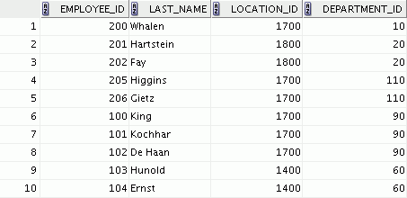
Retrieving Records with the USING Clause
SELECT employees.employee_id, employees.last_name,
departments.location_id, department_id
FROM employees JOIN departments
USING (department_id) ;
…
Notes:
Oracle Database 10g: SQL Fundamentals I 5 - <number>
Retrieving Records with the USING Clause
The slide example joins the DEPARTMENT_ID column in the EMPLOYEES and DEPARTMENTS tables, and thus shows the location where an employee works.

Slide 11
Qualifying Ambiguous
Column Names
  Use table prefixes to qualify column names that are in multiple tables.
  Use table prefixes to improve performance.
  Use column aliases to distinguish columns that have identical names but reside in different tables.
  Do not use aliases on columns that are identified in the USING clause and listed elsewhere in the SQL statement.
Notes:
Oracle Database 10g: SQL Fundamentals I 5 - <number>
Qualifying Ambiguous Column Names
You need to qualify the names of the columns with the table name to avoid ambiguity. Without the table prefixes, the DEPARTMENT_ID column in the SELECT list could be from either the DEPARTMENTS table or the EMPLOYEES table. It is necessary to add the table prefix to execute your query:
SELECT employees.employee_id, employees.last_name,
departments.department_id, departments.location_id
FROM employees JOIN departments
ON employees.department_id = departments.department_id;
If there are no common column names between the two tables, there is no need to qualify the columns. However, using the table prefix improves performance, because you tell the Oracle server exactly where to find the columns.
Note: When joining with the USING clause, you cannot qualify a column that is used in the USING clause itself. Furthermore, if that column is used anywhere in the SQL statement, you cannot alias it.

Slide 12
Using Table Aliases
  Use table aliases to simplify queries.
  Use table aliases to improve performance.
SELECT e.employee_id, e.last_name,
d.location_id, department_id
FROM employees e JOIN departments d
USING (department_id) ;
Notes:
Oracle Database 10g: SQL Fundamentals I 5 - <number>
Using Table Aliases
Qualifying column names with table names can be very time consuming, particularly if table names are lengthy. You can use table aliases instead of table names. Just as a column alias gives a column another name, a table alias gives a table another name. Table aliases help to keep SQL code smaller, therefore using less memory.
Notice how table aliases are identified in the FROM clause in the example. The table name is specified in full, followed by a space and then the table alias. The EMPLOYEES table has been given an alias of e, and the DEPARTMENTS table an alias of d.
Guidelines
Table aliases can be up to 30 characters in length, but shorter aliases are better than longer ones.
If a table alias is used for a particular table name in the FROM clause, then that table alias must be substituted for the table name throughout the SELECT statement.
Table aliases should be meaningful.
The table alias is valid for only the current SELECT statement.

Slide 13
Creating Joins with the ON Clause
  The join condition for the natural join is basically an equijoin of all columns with the same name.
  Use the ON clause to specify arbitrary conditions or specify columns to join.
  The join condition is separated from other search conditions.
  The ON clause makes code easy to understand.
Notes:
Oracle Database 10g: SQL Fundamentals I 5 - <number>
ON Clause
Use the ON clause to specify a join condition. This lets you specify join conditions separate from any search or filter conditions in the WHERE clause.

Slide 14
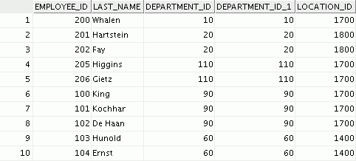
Retrieving Records with the ON Clause
SELECT e.employee_id, e.last_name, e.department_id,
d.department_id, d.location_id
FROM employees e JOIN departments d
ON (e.department_id = d.department_id);
…
Notes:
Oracle Database 10g: SQL Fundamentals I 5 - <number>
Creating Joins with the ON Clause
In this example, the DEPARTMENT_ID columns in the EMPLOYEES and DEPARTMENTS table are joined using the ON clause. Wherever a department ID in the EMPLOYEES table equals a department ID in the DEPARTMENTS table, the row is returned.
You can also use the ON clause to join columns that have different names.

Slide 15
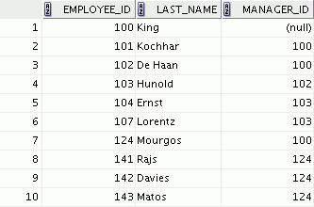
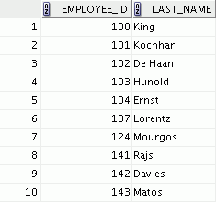
Self-Joins Using the ON Clause
EMPLOYEES (WORKER)
EMPLOYEES (MANAGER)
…
…
MANAGER_ID in the WORKER table is equal to EMPLOYEE_ID in the MANAGER table.
Notes:
Oracle Database 10g: SQL Fundamentals I 5 - <number>
Joining a Table to Itself
Sometimes you need to join a table to itself. To find the name of each employee’s manager, you need to join the EMPLOYEES table to itself, or perform a self join. For example, to find the name of Lorentz’s manager, you need to:
Find Lorentz in the EMPLOYEES table by looking at the LAST_NAME column
Find the manager number for Lorentz by looking at the MANAGER_ID column. Lorentz’s manager number is 103.
Find the name of the manager with EMPLOYEE_ID 103 by looking at the LAST_NAME column. Hunold’s employee number is 103, so Hunold is Lorentz’s manager.
In this process, you look in the table twice. The first time you look in the table to find Lorentz in the LAST_NAME column and MANAGER_ID value of 103. The second time you look in the EMPLOYEE_ID column to find 103 and the LAST_NAME column to find Hunold.

Slide 16
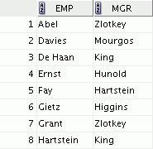
Self-Joins Using the ON Clause
SELECT e.last_name emp, m.last_name mgr
FROM employees e JOIN employees m
ON (e.manager_id = m.employee_id);
…
Notes:
Oracle Database 10g: SQL Fundamentals I 5 - <number>
Joining a Table to Itself (continued)
The ON clause can also be used to join columns that have different names, within the same table or in a different table.
The example shown is a self-join of the EMPLOYEES table, based on the EMPLOYEE_ID and MANAGER_ID columns.

Slide 17

Applying Additional Conditions to a Join
SELECT e.employee_id, e.last_name, e.department_id,
d.department_id, d.location_id
FROM employees e JOIN departments d
ON (e.department_id = d.department_id)
AND e.manager_id = 149 ;
Notes:
Oracle Database 10g: SQL Fundamentals I 5 - <number>
Applying Additional Conditions to a Join
You can apply additional conditions to the join.
The example shown performs a join on the EMPLOYEES and DEPARTMENTS tables and, in addition, displays only employees who have a manager ID of 149. To add additional conditions to the ON clause, you can add AND clauses. Alternatively, you can use a WHERE clause to apply additional conditions:
SELECT e.employee_id, e.last_name, e.department_id,
d.department_id, d.location_id
FROM employees e JOIN departments d
ON (e.department_id = d.department_id)
WHERE e.manager_id = 149;

Slide 18
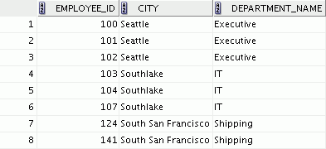
Creating Three-Way Joins with the
ON Clause
SELECT employee_id, city, department_name
FROM employees e
JOIN departments d
ON d.department_id = e.department_id
JOIN locations l
ON d.location_id = l.location_id;
…
Notes:
Oracle Database 10g: SQL Fundamentals I 5 - <number>
Three-Way Joins
A three-way join is a join of three tables. In SQL:1999–compliant syntax, joins are performed from left to right. So, the first join to be performed is EMPLOYEES JOIN DEPARTMENTS. The first join condition can reference columns in EMPLOYEES and DEPARTMENTS but cannot reference columns in LOCATIONS. The second join condition can reference columns from all three tables.

Slide 19
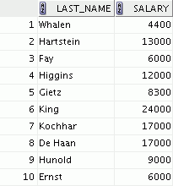
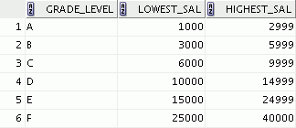
Nonequijoins
EMPLOYEES
JOB_GRADES
…
Salary in the EMPLOYEES
table must be between
lowest salary and highest
salary in the JOB_GRADES
table.
Notes:
Oracle Database 10g: SQL Fundamentals I 5 - <number>
Nonequijoins
A nonequijoin is a join condition containing something other than an equality operator.
The relationship between the EMPLOYEES table and the JOB_GRADES table is an example of a nonequijoin. A relationship between the two tables is that the SALARY column in the EMPLOYEES table must be between the values in the LOWEST_SALARY and HIGHEST_SALARY columns of the JOB_GRADES table. The relationship is obtained using an operator other than equality (=).

Slide 20
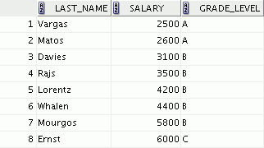
Retrieving Records with Nonequijoins
SELECT e.last_name, e.salary, j.grade_level
FROM employees e JOIN job_grades j
ON e.salary
BETWEEN j.lowest_sal AND j.highest_sal;
…
Notes:
Oracle Database 10g: SQL Fundamentals I 5 - <number>
Nonequijoins (continued)
The slide example creates a nonequijoin to evaluate an employee’s salary grade. The salary must be between any pair of the low and high salary ranges.
It is important to note that all employees appear exactly once when this query is executed. No employee is repeated in the list. There are two reasons for this:
None of the rows in the job grade table contain grades that overlap. That is, the salary value for an employee can lie only between the low salary and high salary values of one of the rows in the salary grade table.
All of the employees’ salaries lie within the limits that are provided by the job grade table. That is, no employee earns less than the lowest value contained in the LOWEST_SAL column or more than the highest value contained in the HIGHEST_SAL column.
Note: Other conditions (such as <= and >=) can be used, but BETWEEN is the simplest. Remember to specify the low value first and the high value last when using BETWEEN.
Table aliases have been specified in the slide example for performance reasons, not because of possible ambiguity.

Slide 21
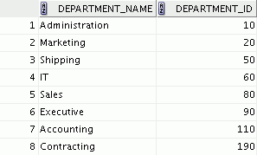
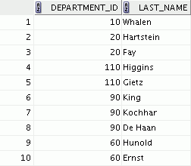
Outer Joins
DEPARTMENTS
EMPLOYEES
…
There are no employees in department 190.
Notes:
Oracle Database 10g: SQL Fundamentals I 5 - <number>
Returning Records with No Direct Match with Outer Joins
If a row does not satisfy a join condition, the row does not appear in the query result. For example, in the equijoin condition of EMPLOYEES and DEPARTMENTS tables, department ID 190 does not appear because there are no employees with that department ID recorded in the EMPLOYEES table. Instead of seeing 20 employees in the result set, you see 19 records.
To return the department record that does not have any employees, you can use an outer join.

Slide 22
INNER Versus OUTER Joins
  In SQL:1999, the join of two tables returning only matched rows is called an inner join.
  A join between two tables that returns the results of the inner join as well as the unmatched rows from the left (or right) tables is called a left (or right) outer join.
  A join between two tables that returns the results of an inner join as well as the results of a left and right join is a full outer join.
Notes:
Oracle Database 10g: SQL Fundamentals I 5 - <number>
INNER Versus OUTER Joins
Joining tables with the NATURAL JOIN, USING, or ON clauses results in an inner join. Any unmatched rows are not displayed in the output. To return the unmatched rows, you can use an outer join. An outer join returns all rows that satisfy the join condition and also returns some or all of those rows from one table for which no rows from the other table satisfy the join condition.
There are three types of outer joins:
LEFT OUTER
RIGHT OUTER
FULL OUTER

Slide 23
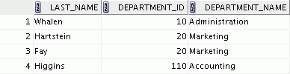

LEFT OUTER JOIN
SELECT e.last_name, e.department_id, d.department_name
FROM employees e LEFT OUTER JOIN departments d
ON (e.department_id = d.department_id) ;
…
Notes:
Oracle Database 10g: SQL Fundamentals I 5 - <number>
Example of LEFT OUTER JOIN
This query retrieves all rows in the EMPLOYEES table, which is the table on the left even if there is no match in the DEPARTMENTS table.

Slide 24


RIGHT OUTER JOIN
SELECT e.last_name, e.department_id, d.department_name
FROM employees e RIGHT OUTER JOIN departments d
ON (e.department_id = d.department_id) ;
…
Notes:
Oracle Database 10g: SQL Fundamentals I 5 - <number>
Example of RIGHT OUTER JOIN
This query retrieves all rows in the DEPARTMENTS table, which is the table on the right even if there is no match in the EMPLOYEES table.

Slide 25

FULL OUTER JOIN
SELECT e.last_name, d.department_id, d.department_name
FROM employees e FULL OUTER JOIN departments d
ON (e.department_id = d.department_id) ;
…
Notes:
Oracle Database 10g: SQL Fundamentals I 5 - <number>
Example of FULL OUTER JOIN
This query retrieves all rows in the EMPLOYEES table, even if there is no match in the DEPARTMENTS table. It also retrieves all rows in the DEPARTMENTS table, even if there is no match in the EMPLOYEES table.

Slide 26
Cartesian Products
  A Cartesian product is formed when:
    A join condition is omitted
    A join condition is invalid
    All rows in the first table are joined to all rows in the second table
  To avoid a Cartesian product, always include a valid join condition.
Notes:
Oracle Database 10g: SQL Fundamentals I 5 - <number>
Cartesian Products
When a join condition is invalid or omitted completely, the result is a Cartesian product, in which all combinations of rows are displayed. All rows in the first table are joined to all rows in the second table.
A Cartesian product tends to generate a large number of rows, and the result is rarely useful. You should always include a valid join condition unless you have a specific need to combine all rows from all tables.
Cartesian products are useful for some tests when you need to generate a large number of rows to simulate a reasonable amount of data.

Slide 27



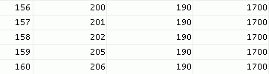
Generating a Cartesian Product
EMPLOYEES (20 rows)
DEPARTMENTS (8 rows)
…
Cartesian product:
20 x 8 = 160 rows
…
Notes:
Oracle Database 10g: SQL Fundamentals I 5 - <number>
Cartesian Products (continued)
A Cartesian product is generated if a join condition is omitted. The example in the slide shows employee last name and department name from the EMPLOYEES and DEPARTMENTS tables. Because no join condition has been specified, all rows (20 rows) from the EMPLOYEES table are joined with all rows (8 rows) in the DEPARTMENTS table, thereby generating 160 rows in the output.

Slide 28
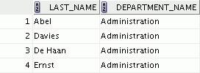

Creating Cross Joins
  The CROSS JOIN clause produces the cross-product of two tables.
  This is also called a Cartesian product between the two tables.
SELECT last_name, department_name
FROM employees
CROSS JOIN departments ;
…
Notes:
Oracle Database 10g: SQL Fundamentals I 5 - <number>
Creating Cross Joins
The example in the slide produces a Cartesian product of the EMPLOYEES and DEPARTMENTS tables.

Slide 29
Summary
In this lesson, you should have learned how to use joins to display data from multiple tables by using:
  Equijoins
  Nonequijoins
  Outer joins
  Self-joins
  Cross joins
  Natural joins
  Full (or two-sided) outer joins
Notes:
Oracle Database 10g: SQL Fundamentals I 5 - <number>
Summary
There are multiple ways to join tables.
Types of Joins
Equijoins
Nonequijoins
Outer joins
Self-joins
Cross joins
Natural joins
Full (or two-sided) outer joins
Cartesian Products
A Cartesian product results in a display of all combinations of rows. This is done by either omitting the WHERE clause or specifying the CROSS JOIN clause.
Table Aliases
Table aliases speed up database access.
Table aliases can help to keep SQL code smaller by conserving memory.

